Slide 1


Natural Language Processing (NLP)
: Dr. Aakash Singh

Slide 2

What is Natural Language
Refers to the languages that humans use naturally to communicate with each other.
Such as English, Spanish, Chinese, Hindi, and thousands of others.
Evolve naturally over time and are governed by complex rules of grammar, syntax, and semantics.
Can be in spoken, written or sign form.

Slide 3
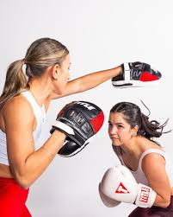

Key Features of Natural Language
Human-Centric
Used for everyday communication among humans.
Developed organically without formal engineering.
Ambiguity
Words and sentences can have multiple meanings depending on context.
Example: "I saw his duck" (Could mean the bird or an action).
Complexity
Governed by rules of grammar and syntax that vary across languages.
Includes nuances like tone, intonation, and stress in spoken forms.
or

Slide 4
Key Features of Natural Language
Context-Dependence
Meaning often depends on context, shared knowledge, and cultural norms.
Example: "Can you pass the salt?" is often a polite request, not a literal inquiry about ability.
Dynamic Evolution
Vocabulary, usage, and grammar rules change over time.
Example: The addition of words like "selfie" or "emoji" to modern dictionaries.

Slide 5
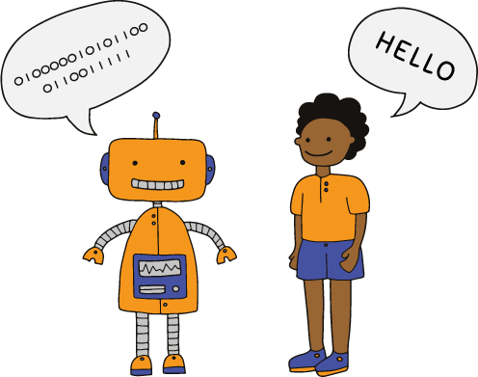
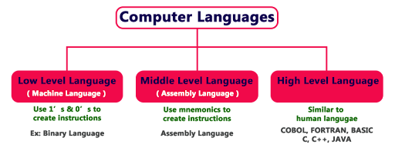
Computer Language
Computers fundamentally understand machine language, which is a low-level language consisting of binary code (0s and 1s).
This binary system represents the on/off states of electrical signals within a computer's hardware.
Programming languages bridge human and computer languages by abstracting complexities, enabling humans to communicate instructions to computers more easily.

Slide 6
Difference
Aspect | Natural Language | Computer (Machine) Language | Programming Language
Purpose | Communication between humans. | Direct communication with computer hardware. | Communication between humans and computers.
Structure | Flexible, less rigid; allows for ambiguity. | Rigid and low-level (binary code). | Structured with strict rules and syntax.
Readability | Easy for humans to understand and use. | Not possible for humans to read and understand. | Human-readable but requires technical knowledge.
Syntax | Varies with context, culture, and grammar. | Binary code, highly specific to machine architecture. | Defined rules and grammar for structured code.
Complexity | Complex and evolving over time. | Simple but complex to work with manually. | Varies from simple (Python) to complex (C++)
Execution | Not directly executable by machines. | Directly executed by machine (hardware). | Needs to be compiled/interpreted into machine code.
Flexibility | Very flexible and ambiguous. | Not flexible; strictly defined by the machine architecture. | Flexible but constrained by syntax rules.
Learning Curve | Easy for native speakers to learn. | Very difficult for humans to directly work with. | Moderate to high, depending on the language.
Error Tolerance | Tolerates errors like typos and slang. | No tolerance for errors; needs to be exact. | Limited error tolerance, strict syntax rules.

Slide 7
Natural Language Processing
Branch of artificial intelligence that focuses on enabling computers to understand, interpret, process, and generate human language in a meaningful way.
Allows machines to interact with human language (natural language) rather than relying solely on structured programming languages.
NLP employs techniques like Rule-Based approch, Machine Learning, and Deep Learning to perform several tasks.

Slide 8
Major Types of NLP Problems
Text Classification
Text Generation
Named Entity Recognition (NER)
Machine Translation
Question Answering (QA)
Text Summarization
Speech-to-Text & Text-to-Speech
Text Similarity

Slide 9
NLP History
The history of Natural Language Processing (NLP) begins with the desire to create systems that allow humans to communicate with machines using natural language.
NLP was "born" in the 1950s when early attempts were made to enable computers to process human language.
Major developments in this era include
Turing Test
Noam Chomsky’s Grammar

Slide 10

Turing Test
Proposed by Alan Turing, the test aimed to determine if a machine could exhibit human-like intelligence in conversation.
This idea directly inspired the development of early conversational systems like chatbots (e.g., ELIZA) and set the vision for creating machines capable of understanding and generating natural language.
The Turing Test emphasised the importance of interaction, driving research in dialogue systems, natural language understanding, and semantics.
Advanced NLP systems, such as GPT-based conversational models, aim to pass the Turing Test by delivering natural, context-aware responses.
Loebner Prize

Slide 11
Noam Chomsky’s Grammar
Defined a formal framework to describe the structure of natural languages.
Classified formal languages (e.g., regular, context-free) foundational for computational linguistics.
Enabled the development of algorithms to analyse sentence structures, essential for NLP tasks.
Proposed a shared underlying structure for all human languages, aiding multilingual NLP.
Early NLP systems like machine translation and syntax analysers relied on his theories.
Rule-based approach to describe the structure of a language.

Slide 12
Georgetown-IBM Experiment
First Public Demonstration of Machine Translation (1954).
Involved translation of Russian sentences into English using IBM's IBM 701 computer.
The translation system used a rule-based word-for-word approach, which focused on matching Russian words with English equivalents.
Input: 60 sentences of Russian text from the UN (United Nations) and scientific papers.
Output: English translations displayed on a screen.
The demonstration created significant excitement in the field of computational linguistics and artificial intelligence.

Slide 13
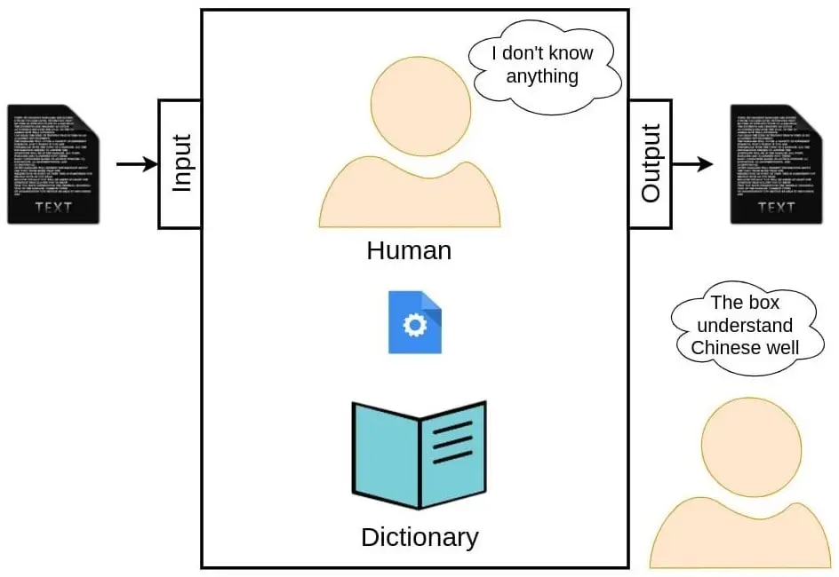
Chinese Room
Introduced by philosopher John Searle in 1980.
Challenges the claims of the Turing Test and the notion that machines can "understand" language in the same way humans do.
Focuses on the distinction between syntax and semantics.
Argues that machines should understand the meaning behind language, not just follow rules.

Slide 14
Statistical & Machine Learning
In the 1980s and 1990s, researchers shifted from rule-based systems to Data-Driven approaches.
The increased availability of computational power and large text corpora facilitated the development of statistical methods such as Hidden Markov Models (HMMs) and Decision Trees.
IBM’s Candide project (1988) introduced statistical methods into machine translation, leading to the development of Statistical Machine Translation (SMT).
The 1990s saw the development of part-of-speech (POS) tagging.
This period also saw progress in identifying and classifying named entities (NER).

Slide 15
Neural Networks & Deep Learning
Neural networks, explored in the 1980s, gained NLP prominence in the 2000s with deep learning advancements.
The breakthrough came in 2013 with Word2Vec by Tomas Mikolov at Google, using neural networks to map words to high-dimensional vectors, improving word semantics by capturing contextual relationships.
RNNs, introduced in the 1980s, gained popularity in the 2000s for handling sequence data, especially in language modeling and machine translation, marking a significant shift in NLP tasks.
LSTM networks, developed in the 1990s, addressed the vanishing gradient problem in RNNs and became widely used in NLP tasks with longer sequences, like speech recognition and text generation.

Slide 16
Transformer Models
In 2017, the Transformer architecture by Vaswani et al. revolutionized NLP by using the attention mechanism, enabling parallel word processing and better capturing long-range dependencies, outperforming RNNs and LSTMs.
In 2018, Google’s BERT model set new performance benchmarks on various NLP tasks. BERT's bidirectional approach to reading text (considering both left and right context) significantly improved tasks like question answering and sentiment analysis.
Models like GPT-2 (2019) and GPT-3 (2020) by OpenAI advanced text generation, using the Transformer architecture to create coherent, context-aware paragraphs, and became widely used in chatbots and content generation.
The pretraining-finetuning paradigm, popularized by models like BERT, GPT, and RoBERTa, allowed for more efficient training on large text corpora and specialized finetuning for specific NLP tasks.

Slide 17
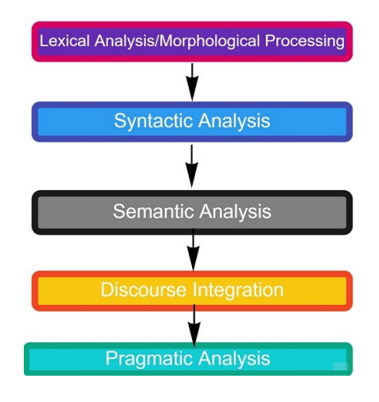
Types of Analysis involved in NLP

Slide 18
Lexical Analysis
The first phase is lexical analysis/morphological processing. In this phase, the sentences, paragraphs are broken into tokens.
These tokens are the smallest unit of text. It scans the entire source text and divides it into meaningful lexemes.
For example, The sentence “He goes to college.” is divided into
[ ‘He’ , ‘goes’ , ‘to’ , ‘college’, ‘.’] .
There are five tokens in the sentence. A paragraph may also be divided into sentences.

Slide 19
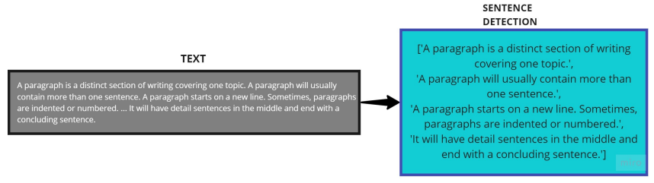
Lexical Analysis

Slide 20
Lexical Analysis
Tokenization: The process of splitting text into individual tokens (words, punctuation marks, numbers, etc.).
Lexical Categories: Tokens are classified into different categories, such as nouns, verbs, adjectives, and adverbs (known as parts of speech).
Normalization: Standardizing tokens by converting them to a consistent form (e.g., lowercasing, stemming, or lemmatization).
Stop-words: Common words that are removed from text before it's analyzed. They are removed because they don't add much meaning to the text.

Slide 21
Syntactic Analysis/Parsing
The second phase is Syntactic analysis. In this phase, the sentence is checked whether it is wellformed or not.
The word arrangement is studied and a syntactic relationship is found between them. It is checked for word arrangements and grammar.
For example, the sentence “Mohan is goes not him” is rejected by the syntactic parser.

Slide 22
Syntactic Analysis/Parsing
Phrase Structure: This refers to the way words are grouped into phrases, such as noun phrases (NP), verb phrases (VP), etc.
Syntactic Tree: The structure that visually represents the syntactic relations of words in a sentence, where each node represents a part of the sentence (word or phrase).
Grammar Rules: These are the formal rules (often context-free grammar) used to define the syntactic structure. For example:
S → NP VP (A sentence is a noun phrase followed by a verb phrase)
NP → Det N (A noun phrase consists of a determiner and a noun)

Slide 23
Semantic Analysis
The third phase is Semantic Analysis. In this phase, the sentence is checked for the literal meaning of each word and their arrangement together.
For example, The sentence “Delhi goes to him” will get rejected by the semantic analyzer because it doesn’t make sense.
E.g.. “colorless green idea.” This would be rejected by the Symantec analysis as colorless Here; green doesn’t make any sense.

Slide 24
Discourse Analysis
Discourse analysis focuses on understanding the structure and meaning of larger units of text or speech (beyond individual sentences). It deals with how the components of a text fit together to convey meaning..
For example, the word “that” in the sentence “He wanted that” depends upon the prior discourse context.
Coherence: Understanding how different sentences logically flow and contribute to the overall meaning of a discourse.
Anaphora and Reference: Anaphora refers to the use of pronouns or other linguistic elements that refer back to something mentioned earlier in the discourse.
Discourse Structure: Identifying the larger structure of a discourse, such as the introduction, body, and conclusion, or argumentation structure.

Slide 25
Pragmatic Analysis
It examines how language is used in practice, including the speaker's intentions, social context, and implied meaning.
The Goal is to interpret the meaning behind a sentence or phrase in a given context, beyond the literal meaning.
Speech Acts: Analyzing the intent behind an utterance, such as requesting, promising, or questioning (e.g., "Can you open the window?" is a request, not just a question).
Implicature: Understanding what is implied but not explicitly stated (e.g., "I’m running late" could imply that the speaker may need the listener’s help or understanding).
Contextual Understanding: Understanding the broader social and situational context in which language is used to determine meaning.

Slide 26
Popular use cases of NLP
Sentiment Analysis
Spam Detection
Resume Mining
Chatbots
Social Media Moderation:
Hate Speech Detection
Offensive Language Detection
Cyberbulling Detection
Profane Content Detection
Hostility Detection

Slide 27
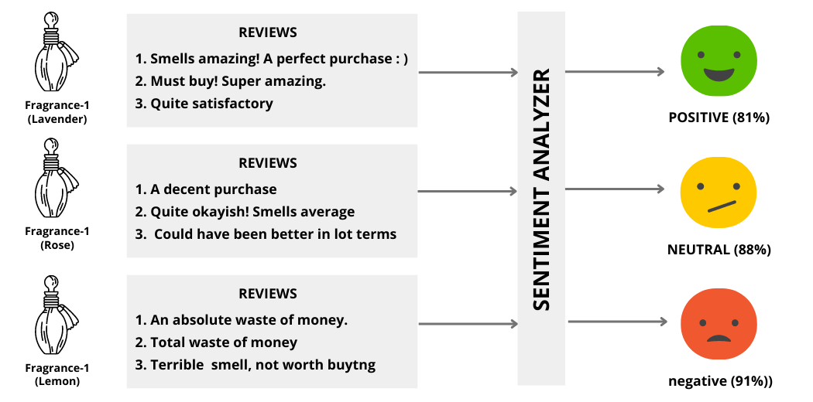
Sentiment Analysis

Slide 28
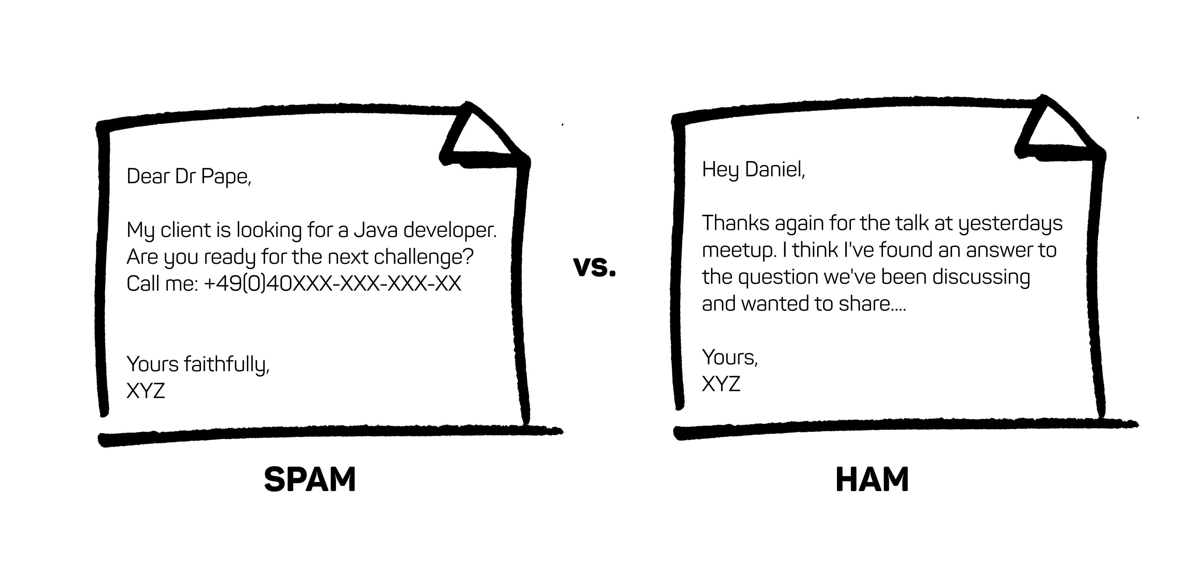
Spam Detection

Slide 29


Resume Mining

Slide 30
ML/ DL compatible data
Anything that can be converted into numbers, we can apply ML/ DL to it.
ML/DL models operate on numerical data as inputs. Converting data into numbers makes it compatible with mathematical computations used in algorithms.
Examples Across Domains:
Text: Words can be converted into numerical vectors (e.g., word embeddings like Word2Vec, BERT).
Images: Images are represented as pixel intensity values in matrices.
Audio: Sound is transformed into numerical waveforms or spectrograms.
Video: Frames (images) and audio are combined into numerical sequences.
Tabular Data: Structured data, like spreadsheets, is already in numerical form or can be encoded (e.g., one-hot encoding for categorical data).

Slide 31
Text to Numbers
One-Hot Encoding
Bag of Words
TF-IDF
GloVe
Word2Vec
Transformer based

Slide 32
One-Hot Encoding
It is a technique used to convert categorical data (such as words or characters) into numerical vectors that can be used by machine learning models. In NLP, one-hot encoding is often applied to represent words in a vocabulary.
Create a Vocabulary: Identify all unique words in the dataset.
For the text "I love NLP", the vocabulary is
["I", "love", "NLP"]
Assign an Index: Assign each word a unique index.
Example:
"I" → 0
“love" → 1
"NLP" → 2

Slide 33
One-Hot Encoding
Create Vectors: Represent each word as a binary vector with the same length as the vocabulary.
The index corresponding to the word is marked as 1.
All other indices are marked as 0.
Example:
"I" → [1, 0, 0]
"love" → [0, 1, 0]
"NLP" → [0, 0, 1]

Slide 34
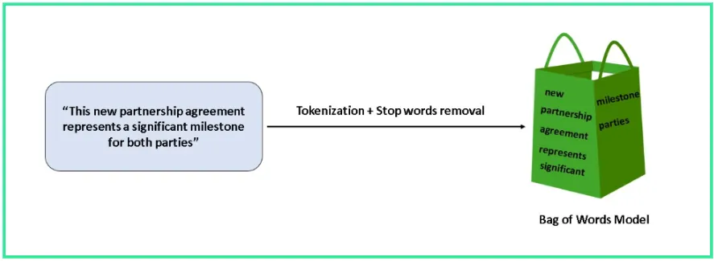
Bag of Words (BoW)
It is a fundamental text representation technique in NLP.
It converts text into numerical vectors based on word frequency, disregarding grammar, word order, and semantics.
It focuses solely on the occurrence of words in a given document or corpus.

Slide 35
Bag of Words (BoW)
Text Preprocessing
Tokenize the text into words.
Convert text to lowercase.
Remove punctuation, stopwords, and special characters.
Create a Vocabulary
List all unique words in the entire corpus.
Generate Vectors
For each document, create a vector indicating the frequency of each word in the vocabulary.
If a word is absent, its frequency is 0.

Slide 36
Bag of Words (BoW)
Corpus:
"He is a good boy."
"She is a good girl."
"Boys and girls are good.“
Step 1: Text Preprocessing
Remove Stopwords: Remove common words like "he," "is," "a," "and," etc.
Stemming: Reduce words to their root form (e.g., "boys" → "boy," "girls" → "girl").
Processed Sentences:
"good boy"
"good girl"
"boy girl good"

Slide 37
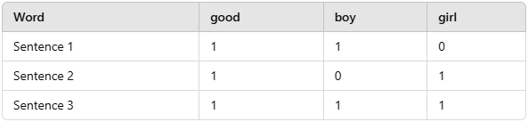
Bag of Words (BoW)
Step 2: Create Vocabulary
Extract unique words: ["good", "boy", "girl"].
Step 3: Generate Frequency Matrix
This table represents the Bag of Words matrix for the given corpus.
There exist several variation on Bag of Word approach.

Slide 38
TF-IDF
It stands for Term Frequency-Inverse Document Frequency.
It is a statistical measure used in Natural Language Processing (NLP) to evaluate the importance of a word in a document relative to a collection (or corpus) of documents.
It combines two components: Term Frequency (TF) and Inverse Document Frequency (IDF).

Slide 39
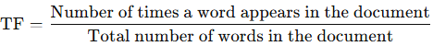
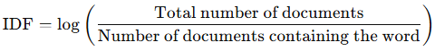
TF-IDF
Term Frequency (TF)
Measures how frequently a term appears in a document.
Formula:
Inverse Document Frequency (IDF)
Measures how unique or rare a word is across all documents.
Words that occur in many documents (e.g., "the," "is") get lower scores, while rare words get higher scores.

Slide 40
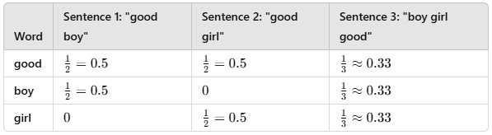
TF-IDF
Corpus:
"He is a good boy."
"She is a good girl."
"Boys and girls are good.“
Vocabulary: ["good", "boy", "girl"]
Compute Term Frequencies (TF)

Slide 41
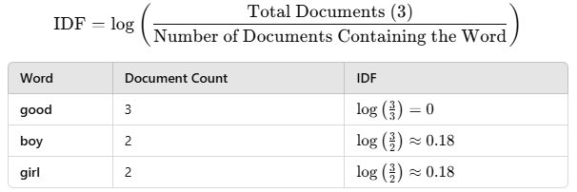
TF-IDF
Compute Inverse Document Frequencies (IDF)

Slide 42
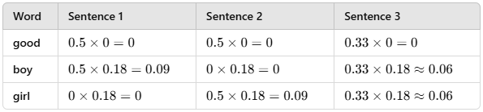
TF-IDF
Compute TF-IDF
Multiply the TF values by the corresponding IDF values

Slide 43
TF-IDF
Practice question:
Document 1 (D1): "The cat sat on the mat.“
Document 2 (D2): "The dog sat on the mat."
Document 3 (D3): "The cat and the dog are friends.“
Document 4 (D4): "Cats and dogs love to play on the mat."

Slide 44
TF-IDF
Preprocessing:
Tokenize,
Lowercase,
Remove Punctuation
Stop Words
D1: ["cat", "sat", "mat"]
D2: ["dog", "sat", "mat"]
D3: ["cat", "dog", "friend"]
D4: ["cat", "dog", "love", "play", "mat"]

Slide 45
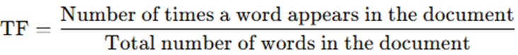
TF-IDF
Term-frequency
Word | D1 TF | D2 TF | D3 TF | D4 TF
cat | 1/3 ≈ 0.33 | 0 | 1/3 ≈ 0.33 | 1/5 = 0.2
dog | 0 | 1/3 ≈ 0.33 | 1/3 ≈ 0.33 | 1/5 = 0.2
sat | 1/3 ≈ 0.33 | 1/3 ≈ 0.33 | 0 | 0
mat | 1/3 ≈ 0.33 | 1/3 ≈ 0.33 | 0 | 1/5 = 0.2
friend | 0 | 0 | 1/3 ≈ 0.33 | 0
love | 0 | 0 | 0 | 1/5 = 0.2
play | 0 | 0 | 0 | 1/5 = 0.2

Slide 46
TF-IDF
Inverse document frequency
Word | Docs Containing Word | IDF
cat | 3 | log(4/3) ≈ 0.13
dog | 3 | log(4/3) ≈ 0.13
sat | 2 | log(4/2) ≈ 0.17
mat | 3 | log(4/3) ≈ 0.13
friend | 1 | log(4/1) ≈ 0.60
love | 1 | log(4/1) ≈ 0.60
play | 1 | log(4/1) ≈ 0.60

Slide 47
TF-IDF
TF x IDF
Word | D1 TF-IDF | D2 TF-IDF | D3 TF-IDF | D4 TF-IDF
cat | 0.33x0.13= 0.04 | 0x0.13= 0 | 0.33x0.13= 0.04 | 0.2x0.13 = 0.03
dog | 0x0.13= 0 | 0.33x0.13= 0.04 | 0.33x0.13= 0.04 | 0.2x0.13 = 0.03
sat | 0.33x0.17= 0.06 | 0.33x0.17= 0.06 | 0x0.17= 0 | 0x0.17 = 0
mat | 0.33x0.13= 0.04 | 0.33x0.13= 0.04 | 0x0.13 = 0 | 0.2x0.13 = 0.03
friend | 0x0.60= 0 | 0x0.60 = 0 | 0.33x0.60= 0.20 | 0x0.60 = 0
love | 0x0.60= 0 | 0x0.60 = 0 | 0x0.60 = 0 | 0.2x0.60 = 0.12
play | 0x0.60= 0 | 0x0.60 = 0 | 0x0.60 = 0 | 0.2x0.60 = 0.12

Slide 48
TF-IDF
Vector representation
D1: [0.04, 0, 0.06, 0.04, 0, 0, 0]
D2: [0, 0.04, 0.06, 0.04, 0, 0, 0]
D3: [0.04, 0.04, 0, 0, 0.20, 0, 0]
D4: [0.03, 0.03, 0, 0.03, 0, 0.12, 0.12]

Slide 49
Document Similarity
Measures how similar two text documents are in terms of content.
Used in NLP for tasks like information retrieval, plagiarism detection, and recommendation systems.
Can be computed using various methods such as Cosine Similarity, Jaccard similarity, and Euclidean distance.
Uses documents as vectors for comparison.

Slide 50
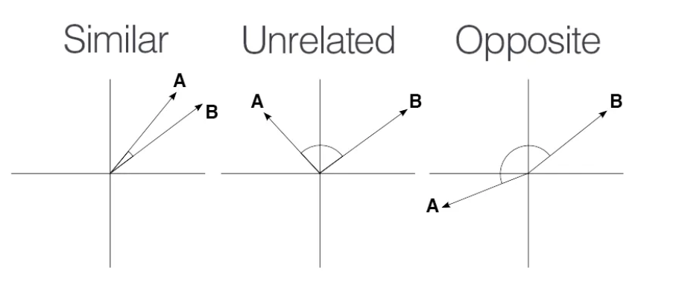
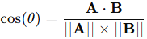
Cosine Similarity
Measures the cosine of the angle between two document vectors in a multi-dimensional space.
Ranges between 0 and 1:
1 → Documents are identical.
0 → Documents are completely different.
Computed as:
A and B are document vectors.
∣∣A∣∣ and ∣∣B∣∣ are vector magnitudes.

Slide 51
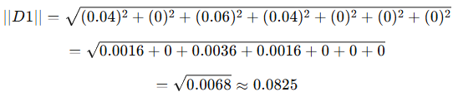
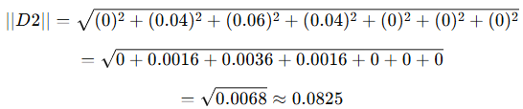
Cosine Similarity
D1 and D2 similarity:
Compute the Dot Product
D1⋅D2= (0.04×0)+(0×0.04)+(0.06×0.06)+(0.04×0.04)+(0×0)+(0×0)+(0×0) =0+0+0.0036+0.0016+0+0+0 =0.0052
Compute the Magnitude of Each Vector:

Slide 52
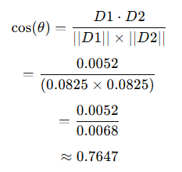
Cosine Similarity
Compute Cosine Similarity

Slide 53
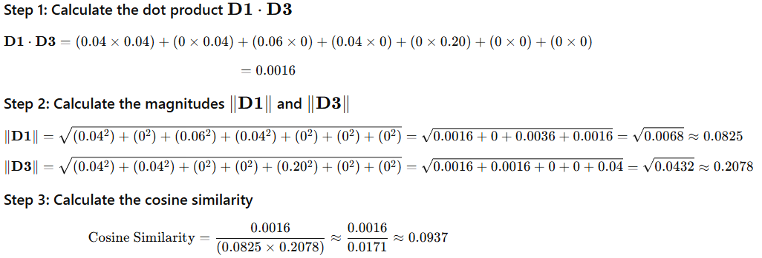
Cosine Similarity
For D1 and D3

Slide 54
Document Classification
Document classification is the process of assigning predefined categories (e.g., sports, politics, spam, non-spam) to text documents using NLP techniques.
Applications:
Spam detection (spam vs. non-spam emails)
Sentiment analysis (positive, negative, neutral)
News categorization (sports, politics, business, etc.)
Legal document classification (contracts, policies, etc.)
Common Algorithms for Classification:
Naïve Bayes
Support Vector Machines (SVM)
Logistic Regression
Deep Learning (LSTMs, Transformers)

Slide 55
Naïve Bayes Classification
The Naïve Bayes classifier is a probabilistic algorithm used for classification tasks.
It is based on Bayes’ Theorem.
It is called "naïve" because it assumes that the features are independent of each other.
This is often not true in real-world scenarios (specially for words in text classification)

Slide 56
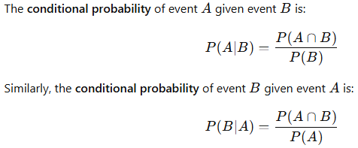
Bayes’ Theorem
Named after the Reverend Thomas Bayes.
Bayes' Theorem is derived using the definition of conditional probability
Conditional probability is known as the possibility of an event or outcome happening, based on the existence of a previous event or outcome.

Slide 57
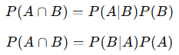
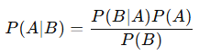
Bayes’ Theorem
From the last equations, we can express the joint probability 𝑃(𝐴∩𝐵)P(A∩B) in two ways:
Since both are equal to 𝑃(𝐴∩𝐵)P(A∩B), we equate them:
Rearranging to solve for 𝑃(𝐴∣𝐵)P(A∣B)

Slide 58
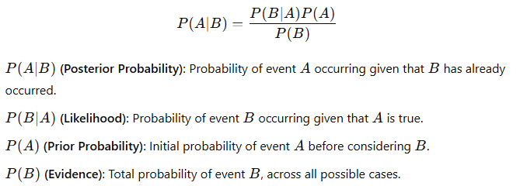
Bayes’ Theorem

Slide 59
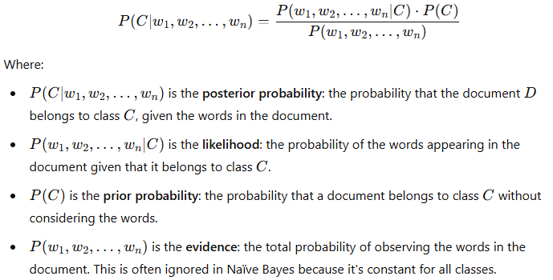
Naïve Bayes Classification
We want to classify a document D (with features/words 𝑤1,𝑤2,…,𝑤𝑛) into a class C
According to Bayes' Theorem, the probability of class C given the document D can be expressed as:

Slide 60
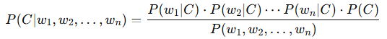
Naïve Bayes Classification
The key assumption in Naïve Bayes is conditional independence.
It assumes that the words (features) in the document are independent of each other, given the class C.
This simplifies the likelihood term:
The formula becomes:

Slide 61
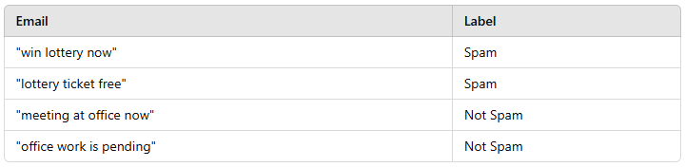
Naïve Bayes Classification
Spam Classification example:
We want to classify the new message:
"free lottery now"

Slide 62
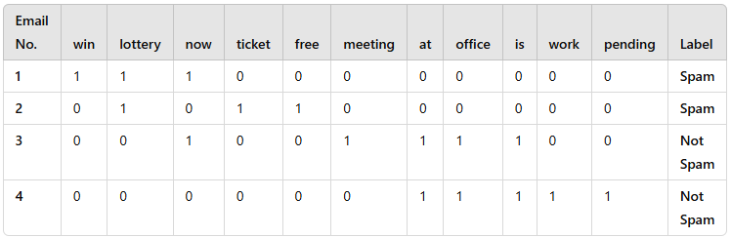
Naïve Bayes Classification
Using bag of word approach:

Slide 63
Naïve Bayes Classification
For example message we have: “free”, “lottery”, “now“
We need to find 2 probabilities:
P(Spam ∣ Message) = P(Spam ∣ " free”, “lottery”, “now“)
P(Not Spam ∣ Message) = P(Spam ∣ " free”, “lottery”, “now“)
P(Spam ∣ “free”, “lottery”, “now“)
P(Not Spam ∣ “free”, “lottery”, “now“)

Slide 64
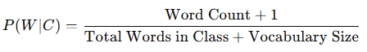
Naïve Bayes Classification
Problem will arise when a word does not appear in a class.
This will make is conditional probability 0.
Since the likelihood probability is the multiple of all the conditional probabilities of words present in example message, it will make net probability 0.
To avoid this we use Laplace Smoothing:

Slide 65
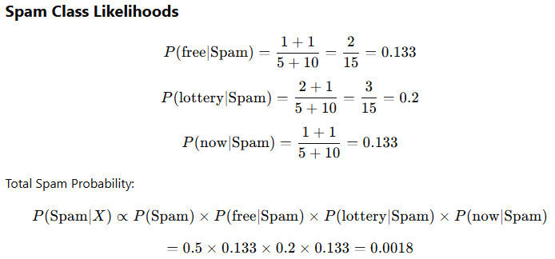
Naïve Bayes Classification
0.125
11
16
0.188
11
16
0.125
11
0.5 x 0.125 x 0.188 x 0.125
0.00147

Slide 66
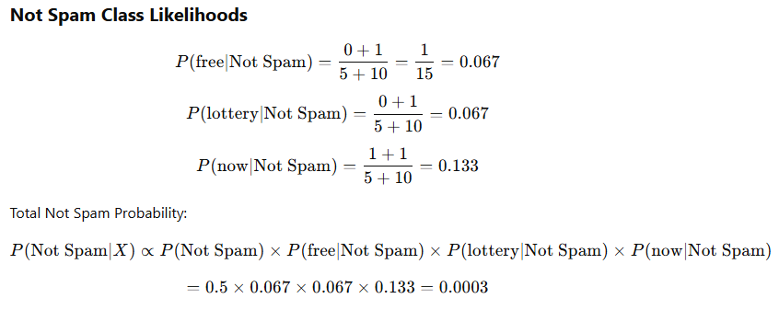
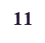
Naïve Bayes Classification
0.056
7
18
0.056
7
0.111
7
0.5 x 0.056 x 0.056 x 0.111
0.00017

Slide 67
Naïve Bayes Classification
Practice example:
“Call office now”

Slide 68
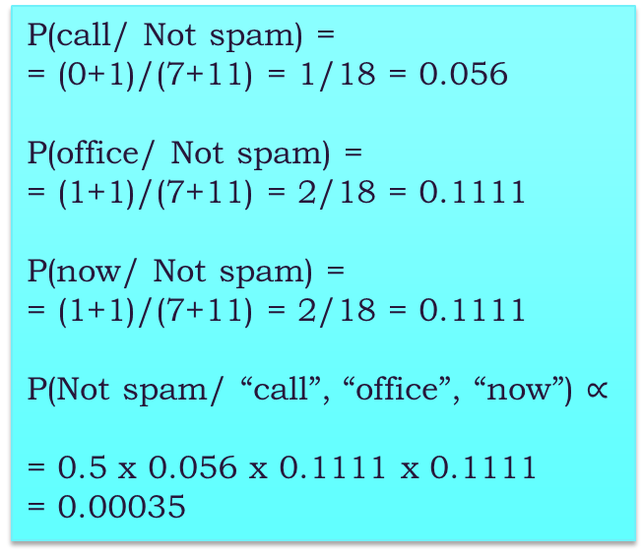
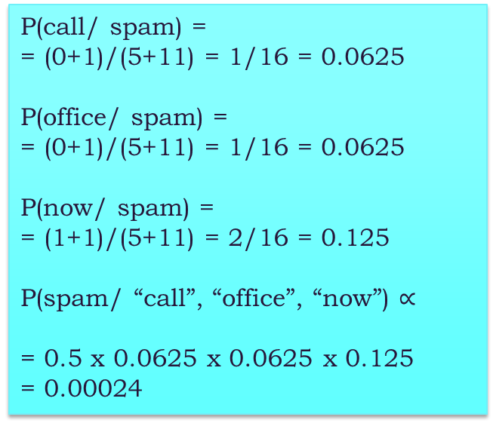
Naïve Bayes Classification
P(call/ spam) =
= (0+1)/(5+11) = 1/16 = 0.0625
P(office/ spam) =
= (0+1)/(5+11) = 1/16 = 0.0625
P(now/ spam) =
= (1+1)/(5+11) = 2/16 = 0.125
P(spam/ “call”, “office”, “now”) $∝$
= 0.5 x 0.0625 x 0.0625 x 0.125
= 0.00024
P(call/ Not spam) =
= (0+1)/(7+11) = 1/18 = 0.056
P(office/ Not spam) =
= (1+1)/(7+11) = 2/18 = 0.1111
P(now/ Not spam) =
= (1+1)/(7+11) = 2/18 = 0.1111
P(Not spam/ “call”, “office”, “now”) $∝$
= 0.5 x 0.056 x 0.1111 x 0.1111
= 0.00035

Slide 69
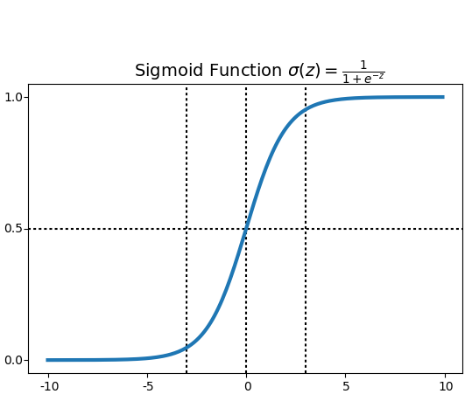
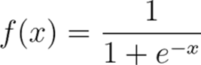
Logistic Regression Classification
A supervised machine learning algorithm used for binary classification.
Computes the probability that an input belongs to one of two classes (e.g., Spam vs. Not Spam).
Uses the sigmoid function to convert numerical values into probabilities.
Where x is a linear combination of the input features.

Slide 70
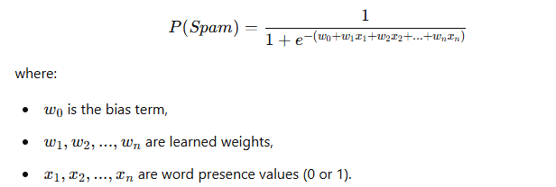
Logistic Regression Classification
Training Logistic Regression:
The model learns a function that predicts whether an email is "Spam" or "Not Spam" based on word presence.
It assigns weights to each word, showing its contribution to predicting spam.
X =

Slide 71
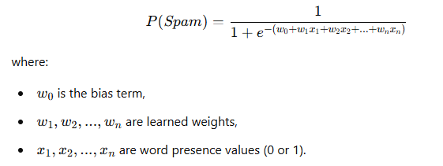
Logistic Regression Classification
Sigmoid Function for Classification
Logistic regression applies a sigmoid function to compute a probability.
Decision Boundary:
If 𝑃>0.5, the email is classified as Spam.
If 𝑃≤0.5, it is classified as Not Spam.
P

Slide 72
Logistic Regression Classification
Limitations:
Assumes a linear relationship among the features.
Performance degrades with huge vocabulary sizes.
Ideally designed for binary classifications only.
How to use it for multi-class classifications?
One vs. Rest approach
One vs. one approach
Use SoftMax function

Slide 73
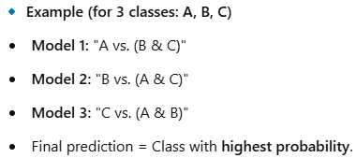
One vs. Rest
Also known as One-vs-All (OvA).
Trains one binary classifier per class while treating all other classes as a single combined class.
The class with the highest probability is chosen as the prediction.
How It Works:
For N classes, train N binary classifiers:
Each classifier distinguishes one class vs. all others.
For a test sample, all classifiers assign probabilities.
The class with the highest probability is the final prediction.

Slide 74
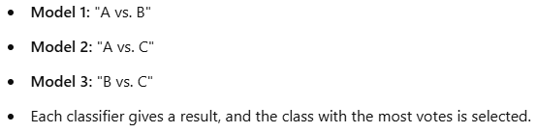
One vs. One approach
Trains binary classifiers for every possible pair of classes.
The final prediction is based on a voting system.
How It Works:
For N classes, train N(N-1)/2 binary classifiers.
Each classifier distinguishes between two classes only.
For a test sample, all classifiers vote for a class.
The class that gets the most votes is the final prediction.

Slide 75
Parametric Vs Non-Parametric
Parametric models make strong assumptions about the functional form of the relationship between input and output variables. They have a fixed number of parameters, regardless of the size of the dataset.
Explicit training: The model tries to learn the value of parameters.
Limited flexibility: Less flexible, constrained by the fixed number of parameters.
Less prone to overfitting but can underfit if assumptions are incorrect.
Example: Linear regression, Logistic regression, ANN
Non-parametric models do not make strong assumptions about the form of the relationship between input and output variables. The number of parameters grows with the size of the dataset, allowing them to adapt to more complex patterns.
No Explicit Training/ Implicit training: The model store & use entire dataset for prediction
High flexibility: Can capture complex, non-linear relationships.
More prone to overfitting, especially with limited data.
Example: k-Nearest Neighbors, Decision tree, Random forest, SOM

Slide 76
Terminologies
 | Definition | Examples
Field | Broad domain where AI/ML is applied. | Natural Language Processing (NLP), Computer Vision (CV), Speech Processing, Time Series Analysis.
Task/Problem | The specific type of problem to solve within a field. | Classification, Regression, Clustering, Translation, Summarization, Question/Answering.
Approach | The method used to solve a task/problem. | Rule-Based Systems, Machine Learning (ML), Deep Learning (DL)

Slide 77
Document Clustering
Text clustering is an unsupervised machine learning technique that groups similar texts together based on their content, without predefined labels.
Text Representation:
Bag-of-Words (BoW)
Term Frequency-Inverse Document Frequency (TF-IDF)
Word Embeddings (Word2Vec, GloVe, FastText)
Contextual embeddings (BERT, GPT)
Techniques:
Partition-based clustering
Hierarchical clustering
Density-based clustering
Topic Modeling

Slide 78
K-Means Clustering
K-Means is an unsupervised machine learning algorithm used for clustering similar data points into K groups (clusters).
It minimizes the distance between data points and the cluster centre (centroid).
Use case: an online store uses K-Means to group customers based on purchase frequency and spending.
The idea is to create segments like Budget Shoppers, Frequent Buyers and Big Spenders for personalized marketing.

Slide 79
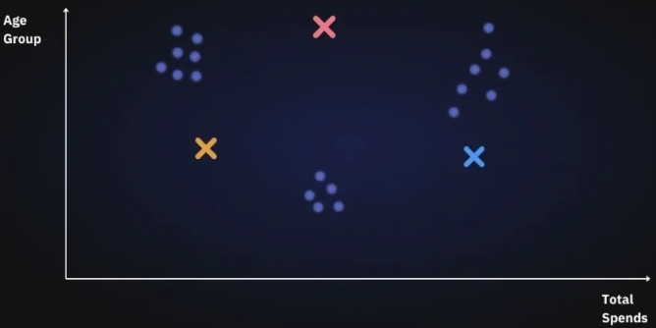
K-Means Clustering
Steps involved:
Choosing the number of clusters The first step is to define the K number of clusters in which we will group the data. Let’s select K=3.
Initializing centroids Centroid is the center of a cluster but initially, the exact center of data points will be unknown so, we select random data points and define them as centroids for each cluster.

Slide 80

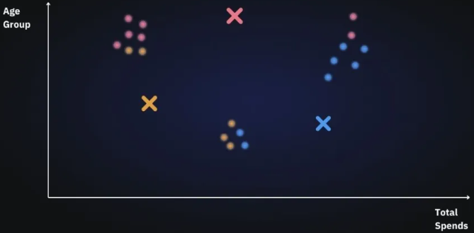
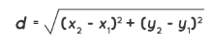
K-Means Clustering
Assign data points to the nearest cluster Now that centroids are initialized, the next step is to assign data points Xn to their closest cluster centroid Ck
In this step, we will first calculate the distance between data point X and centroid C using Euclidean Distance metric.
And then choose the cluster for data points where the distance between the data point and the centroid is minimum.

Slide 81
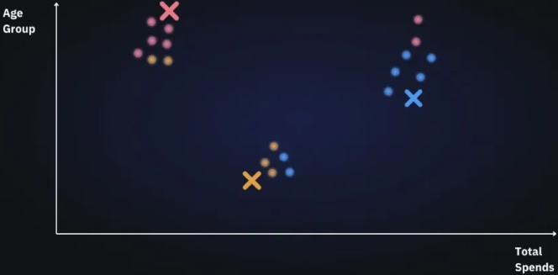
K-Means Clustering
Re-initialize centroids Next, we will re-initialize the centroids by calculating the average of all data points of that cluster.

Slide 82
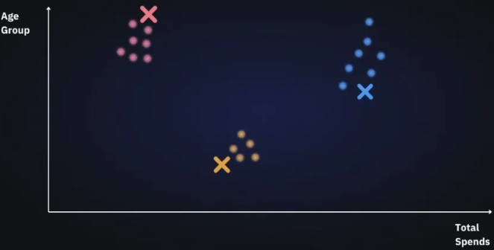
K-Means Clustering
Repeat last two steps We will keep repeating last two steps until we have optimal centroids and the assignments of data points to correct clusters are not changing anymore.

Slide 83
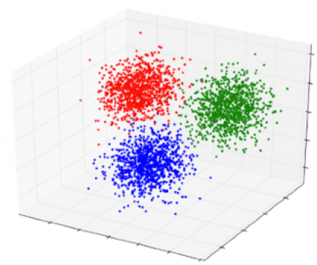
K-Means Clustering
As the number of features increases the number of dimensions also increases.
In the case of text we have words as features (BoW).
So vocabulary size = dimensions involved.

Slide 84
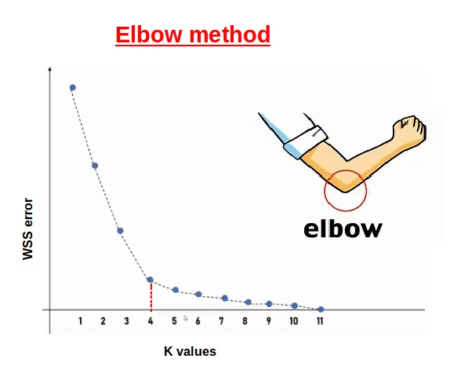
K-Means Clustering
How do you decide the value of k?
In the Elbow Method, we systematically experiment with different numbers of clusters (K) ranging from 1 to 10.
With each K value, we compute the Within-Cluster Sum of Squares (WCSS).
When we plot WCSS against K, the resulting graph resembles an elbow.
As we increase the number of clusters, the WCSS value begins to decrease.

Slide 85
NLP in Information Retrieval
Information Retrieval (IR) is the process of finding relevant information from a large collection of unstructured data (usually text), in response to a user query.
Natural Language Processing (NLP) enhances Information Retrieval (IR) by enabling machines to understand, process, and retrieve relevant information from text-based data.
Applications:
Web Search Engines (Google, Bing)
Chatbots & Conversational Search
Legal & Medical Document Retrieval
Question Answering Systems

Slide 86
NLP in Information Retrieval
Corpus
Document 1: The apple is red.
Document 2: Bananas are yellow and sweet.
Document 3: Grapes can be red or green.
Query:
"red sweet fruit"

Slide 87
NLP in Information Retrieval
Use already known TF-IDF
Step 1: Tokenization (Unique Terms in Corpus)
Terms: ["apple", "red", "bananas", "yellow", "sweet", "grapes", "green"]

Slide 88
NLP in Information Retrieval
Step 2: Term Frequency (TF) Table
Term | Document 1 | Document 2 | Document 3 | Query
apple | 1 | 0 | 0 | 0
red | 1 | 0 | 1 | 1
bananas | 0 | 1 | 0 | 0
yellow | 0 | 1 | 0 | 0
sweet | 0 | 1 | 0 | 1
grapes | 0 | 0 | 1 | 0
green | 0 | 0 | 1 | 0

Slide 89
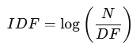
NLP in Information Retrieval
Term | DF | IDF (log⁡(N/DF)
apple | 1 | 0.477
red | 2 | 0.176
bananas | 1 | 0.477
yellow | 1 | 0.477
sweet | 1 | 0.477
grapes | 1 | 0.477
green | 1 | 0.477

Slide 90
NLP in Information Retrieval
Step 2: Compute TF-IDF Scores
Term | Document 1 | Document 2 | Document 3 | Query
apple | 0.477 | 0 | 0 | 0
red | 0.176 | 0 | 0.176 | 0.176
bananas | 0 | 0.477 | 0 | 0
yellow | 0 | 0.477 | 0 | 0
sweet | 0 | 0.477 | 0 | 0.477
grapes | 0 | 0 | 0.477 | 0
green | 0 | 0 | 0.477 | 0

Slide 91

NLP in Information Retrieval
Step 5: Compute Cosine Similarities

Slide 92

NLP in Information Retrieval

Slide 93

NLP in Information Retrieval

Slide 94

NLP in Information Retrieval

Slide 95
NLP in Information Retrieval
Final Ranked Order
Document 2 (Most relevant, highest similarity: 0.54)
Document 1 (Second highest similarity: 0.12)
Document 3 (Least relevant, lowest similarity: 0.087)

Slide 96
Neural Networks for Embedding
Simple, shallow architecture of Word2Vec
Input layer: One-hot vector for the target word (size = vocab size, say |V|)
Hidden layer: Size = embedding dimension (say |N|)
Output layer: Predicts context words (also size = vocab size)

Slide 97


Neural Networks for Embedding
Input layer
Output layer
$$σ$$
Hidden layer
$$σ$$
$$σ$$
|N|
$$σ$$
|V|
|V|

Slide 98
Neural Networks for Embedding
Let’s say:
Corpus: “The cat sat on”
Vocabulary = ["the", "cat", "sat", "on"] → V=4
Embedding dimension N=2 (tiny, just to visualize)
So:
Input weight matrix W: shape = 4×2
Output weight matrix W′: shape = 2×4

Slide 99


Neural Networks for Embedding
Input layer
Output layer
Hidden layer
W
|N|
W’
|V|
|V|
Random Initialization
Random Initialization

Slide 100
Neural Networks for Embedding
We represent the words using one-hot encoding.
Vocabulary = ["the", "cat", "sat", "on"]
One-hot for "cat":
x=[0,1,0,0](only index 1 is 1)
Training Dataset (target, context):
(the, cat)
(cat, the), (cat, sat)
(sat, cat), (sat, on)
(on, sat)

Slide 101
Neural Networks for Embedding
Input layer
Output layer
0
Hidden layer
1
cat
0
0
W
|N|
W’
|V|
|V|
Random Initialization
Random Initialization

Slide 102







Neural Networks for Embedding
0
1
$$.$$
$$=$$
0
0
$$=$$

Slide 103
Neural Networks for Embedding
Backpropagation
Loss = difference between predicted and actual (true label = 1 for "sat")
Gradients are calculated
Both W and W′ are updated via gradient descent:
This process repeats for millions of target-context pairs extracted from a large corpus.

Slide 104
Feedforward Neural Networks
Can also be called multi-layer perceptrons (or MLPs) for historical reasons

Slide 105
Use cases for feedforward networks
Let's consider 2 (simplified) sample tasks:
Text classification
Language modeling
State of the art systems use more powerful neural architectures, but simple models are useful to consider!
105

Slide 106
Sentiment Features
106

Slide 107

Text classification

Slide 108

Text classification

Slide 109
Neural Language Models (LMs)
Language Modeling: Calculating the probability of the next word in a sequence given some history.
We've seen N-gram based LMs
But neural network LMs far outperform n-gram language models
State-of-the-art neural LMs are based on more powerful neural network technology like Transformers
But simple feedforward LMs can do almost as well!
109

Slide 110
A feedforward neural language model (LM) is a feedforward network that takes as input at time t a representation of some number of previous words (wt-1;wt-2,etc.) and outputs a probability distribution over possible next words.
Neural language models represent words in this prior context by their embeddings, rather than just by their word identity as used in n-gram language models.

Slide 111


Slide 112


Slide 113
Using embeddings allows neural language models to generalize better to unseen data.
For example, suppose we’ve seen this sentence in training: “I have to make sure that the cat gets fed.”
Our test set has “I forgot to make sure that the dog gets ….”
N-gram model will fail
But a neural LM, knowing that “cat” and “dog” have similar embeddings, will be able to generalize from the “cat” context to assign a high enough probability to “fed” even after seeing “dog”.

Slide 114
Modeling Time in Neural Networks
Language is inherently temporal
Yet the simple NLP classifiers we've seen (for example for sentiment analysis) mostly ignore time
(Feedforward neural LMs use a "moving window" approach to time.)
Here we introduce a deep learning architecture with a different way of representing time
RNNs and their variants like LSTMs

Slide 115


Slide 116


Slide 117


Slide 118


Slide 119


Slide 120


Slide 121


Slide 122
Teacher forcing
We always give the model the correct history to predict the next word (rather than feeding the model the possible buggy guess from the prior time step).
This is called teacher forcing (in training we force the context to be correct based on the gold words)
What teacher forcing looks like:
At word position t
the model takes as input the correct word wt together with ht−1, computes a probability distribution over possible next words
That gives loss for the next token wt+1
Then we move on to next word, ignore what the model predicted for the next word and instead use the correct word wt+1 along with the prior history encoded to estimate the probability of token wt+2.

Slide 123
RNNs for sequence labeling
Assign a label to each element of a sequence
Part-of-speech tagging

Slide 124
RNNs for sequence classification
Text classification
Instead of taking the last state, could use some pooling function of all the output states, like mean pooling

Slide 125
Bidirectional RNNs for classification

Slide 126
The LSTM: Long short-term memory network
LSTMs divide the context management problem into two subproblems:
removing information no longer needed from the context,
adding information likely to be needed for later decision making
LSTMs add:
explicit context layer
Neural circuits with gates to control information flow

Slide 127
Units
FFN
SRN
LSTM

Slide 128
Four architectures for NLP tasks with RNNs

Slide 129
3 components of an encoder-decoder
An encoder that accepts an input sequence, x1:n, and generates a corresponding sequence of contextualized representations, h1:n.
A context vector, c, which is a function of h1:n, and conveys the essence of the input to the decoder.
A decoder, which accepts c as input and generates an arbitrary length sequence of hidden states h1:m, from which a corresponding sequence of output states y1:m, can be obtained

Slide 130
Encoder-decoder simplified

Slide 131
Encoder-decoder showing context

Slide 132
Problem with passing context c only from end
Requiring the context c to be only the encoder’s final hidden state forces all the information from the entire source sentence to pass through this representational bottleneck.

Slide 133
Solution: attention
instead of being taken from the last hidden state, the context it’s a weighted average of all the hidden states of the decoder.
this weighted average is also informed by part of the decoder state as well, the state of the decoder right before the current token i.

Slide 134
Encoder-decoder with attention, focusing on the computation of c

Slide 135
LLMs are built out of transformers
Transformer: a specific kind of network architecture, like a fancier feedforward network, but based on attention
Notes:
D

Slide 136

Problem with static embeddings (word2vec)
They are static! The embedding for a word doesn't reflect how its meaning changes in context.
The chicken didn't cross the road because it was too tired
What is the meaning represented in the static embedding for "it"?
Notes:
D

Slide 137
Contextual Embeddings
Intuition: a representation of meaning of a word should be different in different contexts!
Contextual Embedding: each word has a different vector that expresses different meanings depending on the surrounding words
How to compute contextual embeddings?
Attention

Slide 138
Contextual Embeddings
The chicken didn't cross the road because it
What should be the properties of "it"?
The chicken didn't cross the road because it was too tired
The chicken didn't cross the road because it was too wide
At this point in the sentence, it's probably referring to either the chicken or the street
Notes:
But the static meaning of "it" can't represent that, it just means "I am a non-human pronoun".

Slide 139
Intuition of attention
Build up the contextual embedding from a word by selectively integrating information from all the neighboring words
We say that a word "attends to" some neighboring words more than others

Slide 140
Intuition of attention:
test
Notes:
D

Slide 141
Attention definition
A mechanism for helping compute the embedding for a token by selectively attending to and integrating information from surrounding tokens (at the previous layer).
More formally: a method for doing a weighted sum of vectors.
Notes:
D

Slide 142
Attention is left-to-right

Slide 143
Simplified version of attention: a sum of prior words weighted by their similarity with the current word
Given a sequence of token embeddings:
x₁ x₂ x₃ x₄ x₅ x₆ x₇ x_{i}
Produce: a_{i} = a weighted sum of x₁ through x₇ (and x_{i})
Weighted by their similarity to x_{i}
Notes:
D

Slide 144
Intuition of attention:
test
x1 x2 x3 x4 x5 x6 x7 xi
Notes:
D

Slide 145
An Actual Attention Head: slightly more complicated
High-level idea: instead of using vectors (like x_{i} and x₄) directly, we'll represent 3 separate roles each vector x_{i} plays:
query: As the current element being compared to the preceding inputs.
key: as a preceding input that is being compared to the current element to determine a similarity
value: a value of a preceding element that gets weighted and summed
Notes:
The word head is used in transformers to refer to specific structured layers

Slide 146
An Actual Attention Head: slightly more complicated
We'll use matrices to project each vector x_{i} into a representation of its role as query, key, value:
query: W^{Q}
key: W^{K}
value: W^{V}

Slide 147
An Actual Attention Head: slightly more complicated
Given these 3 representation of x_{i}
To compute similarity of current element x_{i} with some prior element x_{j}
We’ll use dot product between q_{i} and k_{j}.
This will give us attention “α_{ij}” and using this we calculate v_{j}
And instead of summing up x_{j} , we'll sum up v_{j}

Slide 148
Final equations for one attention head
Notes:
the result of a dot product can be an arbitrarily large (positive or negative) value, and exponentiating large values can lead to numerical issues and loss of gradients during training. To avoid this, we scale the dot product by a factor related to the size of the embeddings, via diving by the square root of the dimensionality of the query and key vectors (dk).

Slide 149
Calculating the value of a3

Slide 150
Actual Attention: slightly more complicated
Instead of one attention head, we'll have lots of them!
Intuition: each head might be attending to the context for different purposes
Different linguistic relationships or patterns in the context
Notes:
Up to 128 in Lllama3 405B

Slide 151
Multi-head attention

Slide 152
Summary
Attention is a method for enriching the representation of a token by incorporating contextual information
The result: the embedding for each word will be different in different contexts!
Contextual embeddings: a representation of word meaning in its context.
We'll see in the next lecture that attention can also be viewed as a way to move information from one token to another.

